Slide 1
Functional Programming
Optional
Stream API

Slide 2
Functional programming paradigm
Style of building the structure and elements of computer programs
Avoiding mutable data, changing state, side effects;
Output value of a function depends only on the arguments that are input to the function;
Function with the same arguments always returns the same result;
Rely on the notion of deferred execution.

Slide 3
Functional interface
any interface with one abstract method
its implementation may be treated as lambda expressions.
unlimited count of default methods
unlimited count of static methods
unlimited count of private methods

Slide 4
Functional interface
@FunctionalInterface interface Speakable { String say();
static void someStatic() { System.out.println("In static..."); }
default void someDefault() { System.out.println("In default..."); }
private void somePrivate() { System.out.println("In private..."); } }

Slide 5
Anonymous class
doesn't have a specified name
used to create a single instance of a class that implements a specific interface (not necessarily functional) or extends a specific class
used for short and simple implementations of interfaces or abstract classes

Slide 6
Anonymous class example
@FunctionalInterface
interface Translator {
String translate(String input);
}
public class Main {
public static void main(String[] args) {
Translator translator = new Translator() {
@Override
public String translate(String input) {
return input.toLowerCase();
}
};
translator.translate("Example");
}
}

Slide 7
Lambda
parameter name
body
(Task val) -> {return val.execute();}
optional parameter type
required because in block
arrow

Slide 8
Lambda examples
1. s -> s.length()
2. (int a, int b) -> a + b
3. () -> 42
4. (x, y, z) -> {
if (x) {
return y;
} else {
return z;
}
}
A lambda body is either a
single expression or a block

Slide 9
Lambda and Anonymous class difference
this keyword behavior is different
For an anonymous class, this keyword resolves to the anonymous class itself. For a lambda expression - class where the lambda is written.
Different compiled bytecode
Anonymous classes are compiled into inner classes. Lambda expressions are converted into private static (in some cases) methods of their enclosing class and, using the invoke dynamic instruction.

Slide 10
Anonymous class vs Lambda
@FunctionalInterface
interface Translator {
String translate(String input);
}
Translator oldSchool = new Translator() {
@Override
public String translate(String input) {
return input.toLowerCase();
}
};
Translator newSchool = input -> input.toLowerCase();
Translator newerSchool = String::toLowerCase;

Slide 11
Anonymous class vs Lambda
List<Car> cars = new ArrayList<>(List.of(new Car("ZAZ"), new Car("Volkswagen"),
new Car("Bentley"), new Car("BMW")));
Collections.sort(cars, new Comparator<Car>() {
@Override
public int compare(Car o1, Car o2) {
return o1.name().compareTo(o2.name());
}
});
Collections.sort(cars, (o1, o2) -> o1.name().compareTo(o2.name()));
Collections.sort(cars, Comparator.comparing(Car::name));
System.out.println(cars);
// [Car[name=BMW], Car[name=Bentley], Car[name=Volkswagen], Car[name=ZAZ]]

Slide 12
Accessibility
Lambda expressions can access:
static variables
instance variables
effectively final method parameters
effectively final local variables
does not allow checked exceptions (if not declared in the interface signature)

Slide 13
Method reference
Sometimes a lambda expression does nothing but call an existing method. In those cases, it's often clearer to refer to the existing method by name.
A method reference is the shorthand syntax to a lambda expression that executes just one method.

Slide 14
Method reference
Reference to a static method
AnimalFactory::newAnimal
Reference to an instance method of a particular object
zoo::addAnimal
Reference to an instance method of an arbitrary object of a particular type
Animal::getPawsCount
Reference to a constructor
Animal::new

Slide 15
Static method reference
class StudentUtils { public static boolean isGraduated(int num) { return num >= 60; } public static List<Integer> filterGraduated( List<Integer> scores,
Predicate<Integer> predicate
) { List<Integer> result = new ArrayList<>(); for (Integer i : scores) { if (p.test(i)) { result.add(i); } } return result; } }

Slide 16
Static method reference
List<Integer> list = Arrays.asList(12, 5, 55, 68, 40); List<Integer> result = filterGraduated(list, new Predicate<Integer>() { public boolean test(Integer score) { return StudentUtils.isGraduated(score); } });
List<Integer> result = filterGraduated(list, i -> StudentUtils.isGraduated(i)); List<Integer> result = filterGraduated(list, StudentUtils::isGraduated);

Slide 17
Reference instance method of an object
Mechanic mechanic = new Mechanic(); Car car = new Car(); execute(car, new Consumer<Car>() { public void accept(Car c) { mechanic.fix(c); } }); execute(car, c -> mechanic.fix(c)); execute(car, mechanic::fix);
static void execute(Car car, Consumer<Car> c) { c.accept(car); }
class Mechanic { void fix(Car c) {…} }
class Car { int id; //... }

Slide 18
Instance method of object of a particular type
List<Shipment> l = new ArrayList<>();
calc(l, new Function<Shipment, Double>() { public Double apply(Shipment s) { // The object return s.calculateWeight(); // The method } });
calc(l, s -> s.calculateWeight());
calc(l, Shipment::calculateWeight);
static List<Double> calc(List<Shipment> l, Function<Shipment, Double> f) { List<Double> results = new ArrayList<>(); l.forEach(s -> results.add(f.apply(s))); return results; }
class Shipment { double calculateWeight() {…} }

Slide 19
Reference to a constructor
Supplier<List<String>> s = new Supplier() { public List<String> get() { return new ArrayList<String>(); } }; List<String> l = s.get();
Supplier<List<String>> s = () -> new ArrayList<String>(); List<String> l = s.get();
Supplier<List<String>> s = ArrayList::new; List<String> l = s.get();

Slide 20
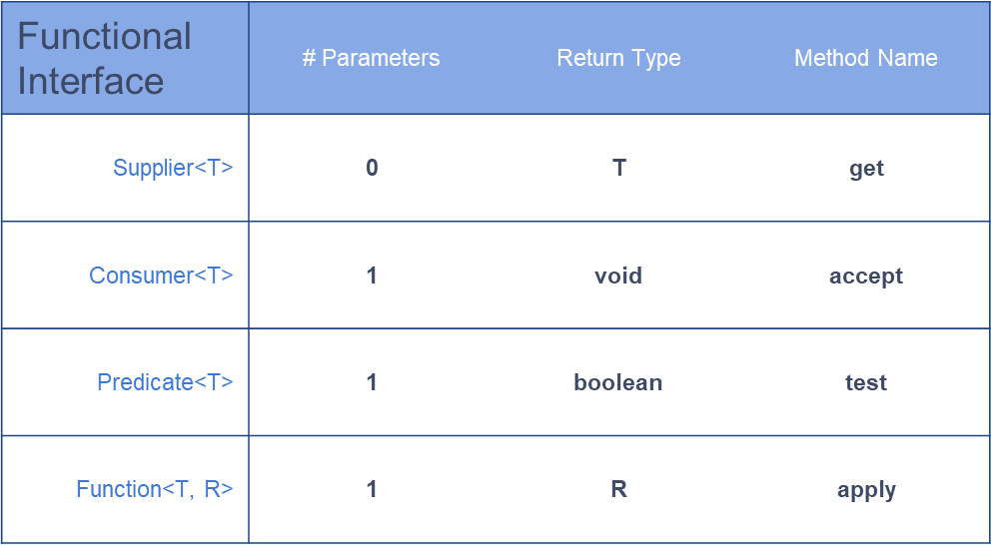
Common built-in functional interfaces

Slide 21
Supplier
@FunctionalInterface interface Supplier<T> { T get(); }
class Car { //... }
public static void main(String[] args) { Supplier<Car> suppl1 = () -> new Car(); Supplier<Car> suppl2 = Car::new; Supplier<Car> suppl3 = new Supplier<Car>() { @Override public Car get() { return new Car(); } };
println(suppl1.get()); //Car@26275bef println(suppl1.get()); //Car@7690781 println(suppl2.get()); //Car@77eca502 println(suppl2.get()); //Car@3246fb96 println(suppl3.get()); //Car@2e222612 println(suppl3.get()); //Car@61386958 println(suppl1);//Main$$Lambda$76/0x000000080012d840@73ee04c8 println(suppl2);//Main$$Lambda$77/0x000000080012dc40@7671cb68 println(suppl3);//Main$1@49dc7102 }

Slide 22
Consumer
@FunctionalInterface interface Consumer<T> { void accept(T t); }
class Car { //... }
public static void main(String[] args) { Supplier<Car> supplier1 = () -> new Car(); Supplier<Car> supplier2 = Car::new;
Consumer<Car> consumer1 = System.out::println; Consumer<Car> consumer2 = car -> System.out.print(car); consumer1.accept(supplier1.get()); //Car@14c966a consumer1.accept(supplier2.get()); //Car@14d3709 consumer2.accept(supplier1.get()); //Car@50df2e consumer2.accept(supplier2.get()); //Car@181eb93 }

Slide 23
Predicate
@FunctionalInterface interface Predicate<T> { boolean test(T t); }
class Car { //... boolean isElectric() { return false; } }
public static void main(String[] args) { Predicate<Car> predicate1 = car -> car.isElectric(); Predicate<Car> predicate2 = Car::isElectric; Supplier<Car> supplier = Car::new;
println(predicate1.test(supplier.get()));//false
println(predicate2.test(supplier.get()));//false }

Slide 24
Function
@FunctionalInterface interface Function<T, R> { R apply(T t); }
class Berry { //... }
class Jam { Jam(Berry berry) { // magic } }
public static void main(String[] args) {
Function<Berry,Jam> factory1 = Jam::new; Function<Berry,Jam> factory2 = berry -> new Jam(berry); println(factory1.apply(new Berry())); //Jam@1eba861 println(factory2.apply(new Berry())); //Jam@1480cf9 }

Slide 25
Billion-Dollar mistake

Slide 26
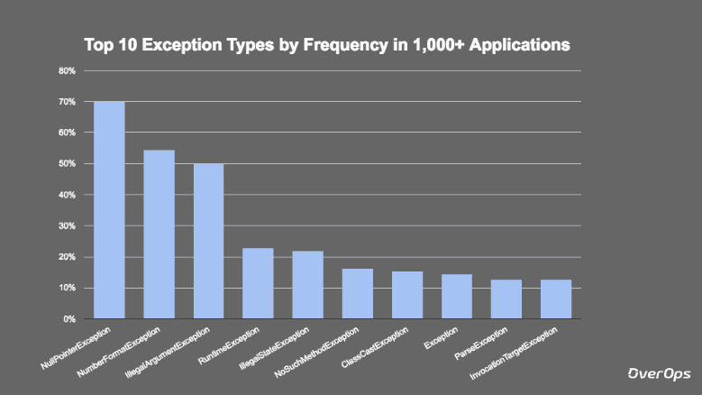
Most frequent exception

Slide 27
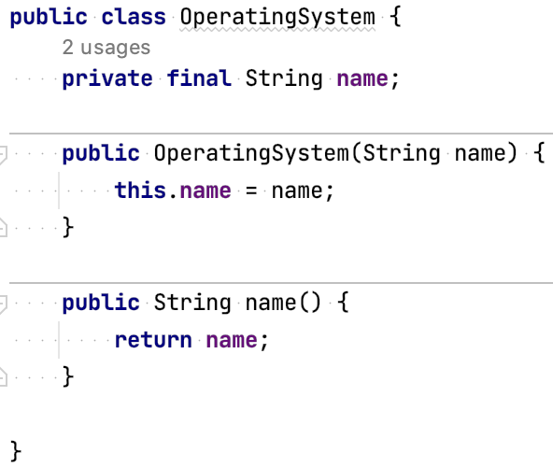
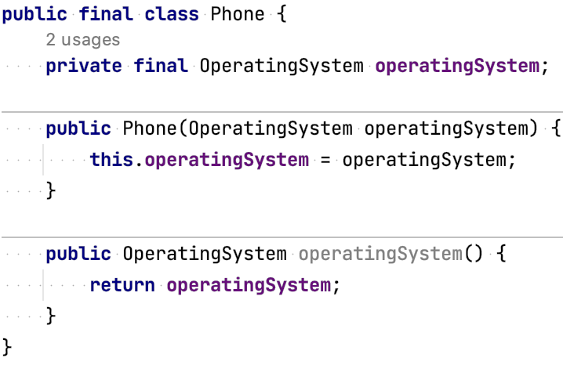
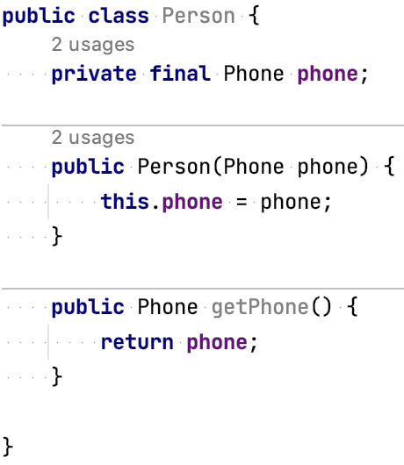
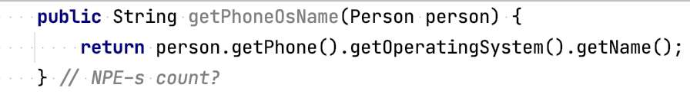
NPE example

Slide 28
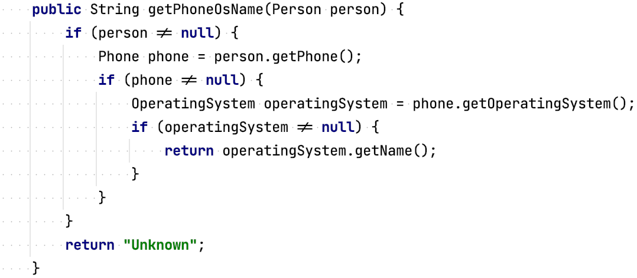
Attempt 1: Null checks

Slide 29
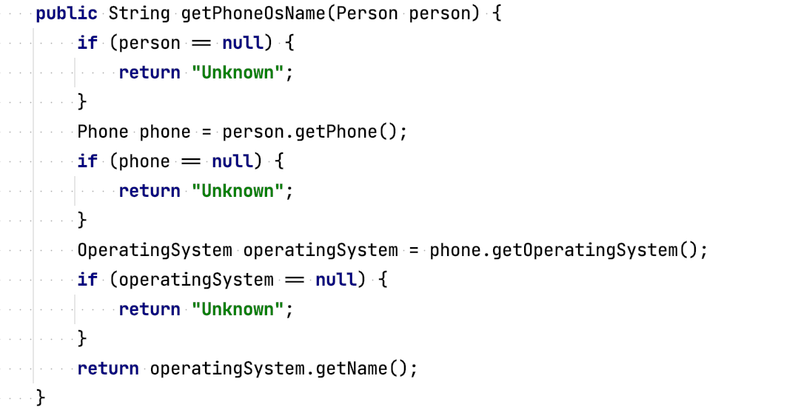
Attempt 2: Multiple Exits

Slide 30
Optional — for the rescue

Slide 31
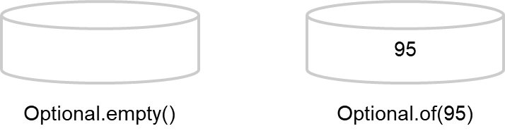
java.util.Optional — for the rescue
Encapsulates optional values
Designed to address the problem of dealing with potentially null values in a more concise and safer way
We can’t easy operate with null, but we can operate with Optional.empty()
Not intended to replace all null references
Design more comprehensible APIs
Forces caller to deal with the absence of a value

Slide 32
How to create Optional objects
Empty Optional
Optional<T> opt = Optional.empty();
Optional<Phone> phoneOpt = Optional.empty();
Optional from a non-null value
Optional<T> opt = Optional.of(T value);
Optional<Phone> phoneOpt = Optional.of(phone);
Optional from a null value
Optional<T> opt = Optional.ofNullable(T value);
Optional<Phone> phoneOpt = Optional.ofNullable(phone);

Slide 33
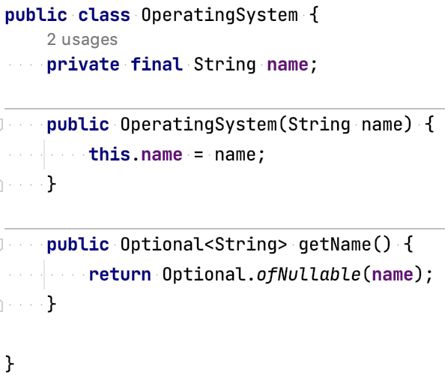
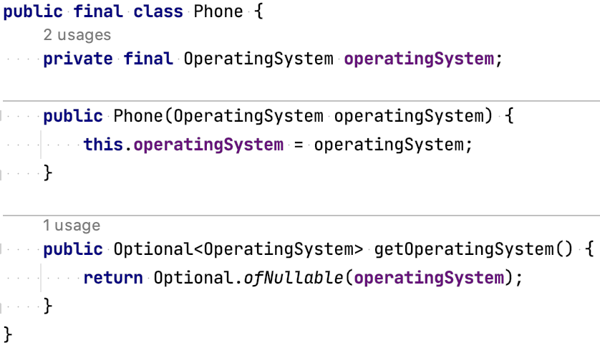
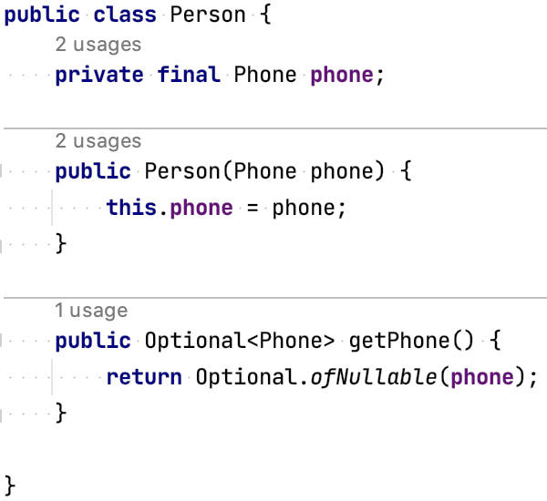
Attempt 3: Refactoring with Optional

Slide 34
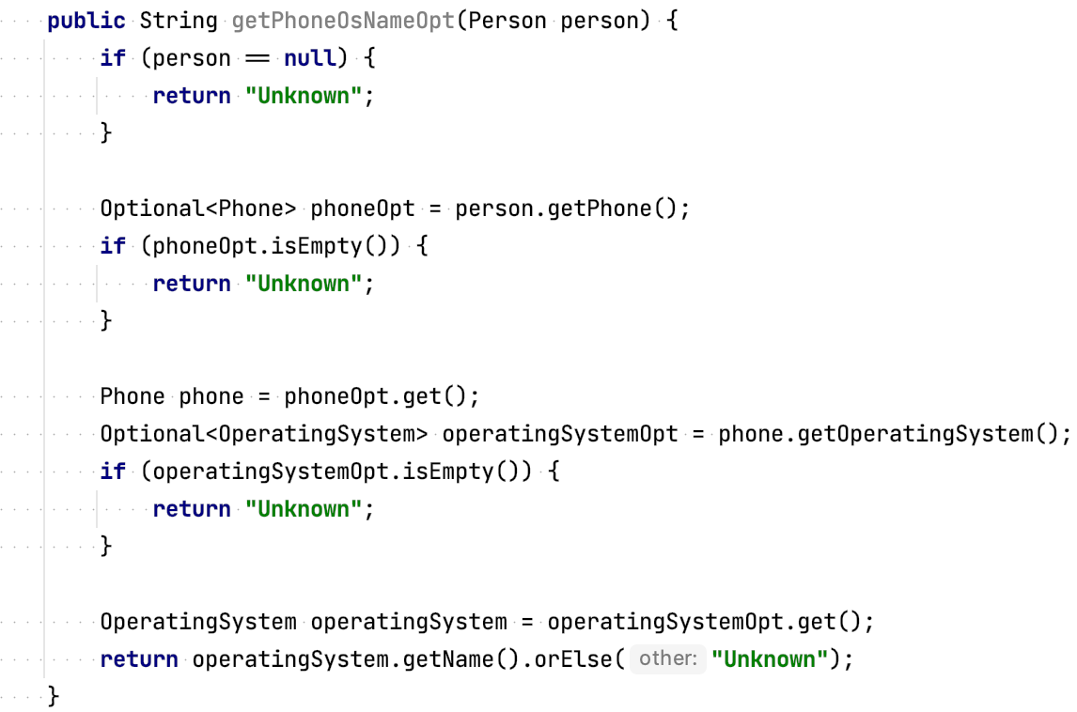
Attempt 3: Optional is easy 😈

Slide 35
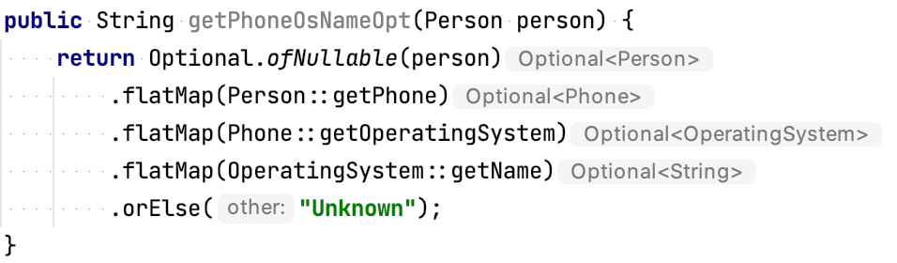
Attempt 4: Optional is easy 😇

Slide 36
Optional Methods
T get(); boolean isPresent(); boolean isEmpty(); void ifPresent(Consumer<? super T> action); void ifPresentOrElse(Consumer<? super T> action, Runnable emptyAction); Optional<T> filter(Predicate<? super T> predicate); <U> Optional<U> map(Function<? super T, ? extends U> mapper); <U> Optional<U> flatMap(Function<? super T, ? extends Optional<? extends U>> mapper); Optional<T> or(Supplier<? extends Optional<? extends T>> supplier); Stream<T> stream(); T orElse(T other); T orElseGet(Supplier<? extends T> supplier); T orElseThrow(); <X extends Throwable> T orElseThrow(Supplier<? extends X> exceptionSupplier) throws X;

Slide 37
Optional Summary
Null references have been historically introduced to indicate absence of value
Optional has been introduced to model presence or absence
Can create Optional objects using factory methods:
Optional.empty
Optional.of
Optional.ofNullable
Optional supports methods suited for functional programming
Using Optional forces callers to actively deal with potential absences
Optional can help you design better APIs

Slide 38
Stream API

Slide 39
Stream
Stream — a sequence of data
Stream pipeline — operations that run on a stream to produce a result
Finite and infinite
Lazy evaluated
Parallel / sequential
Not reusable

Slide 40
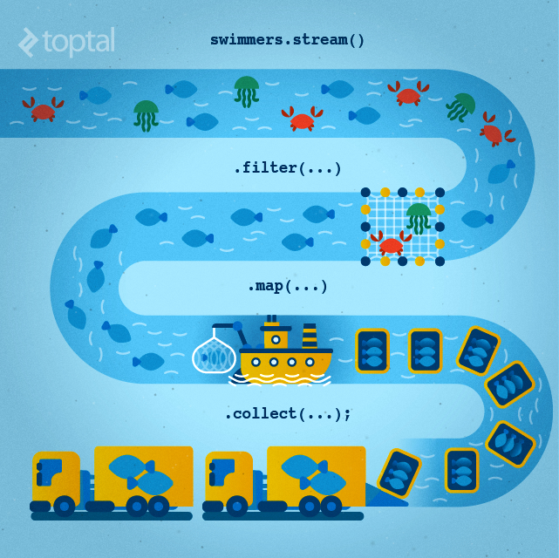
Stream

Slide 41
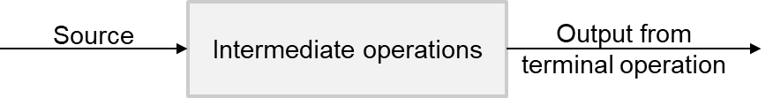
Stream parts
Source
Intermediate operations
Terminal operation

Slide 42
How to Obtain a Stream (source)
List<Integer> list = Arrays.asList(1, 2, 3, 4);
Stream<Integer> fromList = list.stream();
Stream<Integer> fromListParallel = list.parallelStream();
Stream<String> empty = Stream.empty();
Stream<Integer> fromElements = Stream.of(1,2);
Integer[] ints = {1,2,3};
Stream<Integer> fromArray = Stream.of(ints);
Stream<Integer> fromArray2 = Arrays.stream(ints);
Stream<Double> randoms = Stream.generate(Math::random);
Stream<Integer> oddNumbers = Stream.iterate(1, n -> n + 2);

Slide 43
Stream intermediate operations
filter() - return a new stream that contains elements that match its predicate.
map() - transform the elements in a stream using the provided java.util.function.Function
flatMap() - transform each element into zero or more elements by a way of another stream
peek() - allows to peek into the stream before an action is encountered
distinct() - find unique elements in a stream according to their .equals() behavior.
sorted() - return a stream sorted according to natural order (or passed comparator)
limit() - limit the number or truncate elements to be processed in the stream
skip() - skip the start elements to be processed in the stream

Slide 44
Stream intermediate operations
Supplier<Stream<Integer>> numbers = () -> Stream.of(5, 4, 1, 3); numbers.get().filter(num -> num > 3).collect(toList()); // [5, 4] numbers.get().map(num -> num * 2).collect(toList()); // [10, 8, 2, 6] numbers.get().peek(System.out::println).collect(toList()); // [5, 4, 1, 3]
numbers.get().distinct().collect(toList()); // [5, 4, 1, 3]
numbers.get().sorted().collect(toList()); // [1, 3, 4, 5] numbers.get().limit(3).collect(toList()); // [5, 4, 1]
numbers.get().skip(2).collect(toList()); // [1, 3]

Slide 45
Stream terminal operations
allMatch() - check every element in the stream and find out if it matches the predicate
anyMatch() - find out whether at least one of the elements in the stream matches a given predicate.
noneMatch() - find if no elements in the stream match the specified predicate
collect() - convert the stream into some other container such as a list.
count() - find the number of elements in the stream
findAny() - find any element in a given stream.
findFirst() - find the first element in the stream
forEach() - perform an action for each element in the stream
min()/max() - find the minimum or maximum of a stream
reduce() - combine the stream elements into one using a BinaryOperator

Slide 46
Stream terminal operations
Supplier<Stream<Integer>> numbers = () -> Stream.of(5, 4, 1, 3); numbers.get().allMatch(n -> n > 0); // true
numbers.get().anyMatch(n -> n > 4); // true
numbers.get().noneMatch(n -> n > 0); // false
numbers.get().map(n -> n * n).toList(); // [25, 16, 1, 9]
numbers.get().map(n -> n * n).collect(Collectors.toSet());
numbers.get().count(); // 4 numbers.get().findAny(); // Optional[5] numbers.get().findFirst(); // Optional[5] numbers.get().forEach(System.out::println); // 5 4 1 3
numbers.get().max(comparingInt(n -> n)); // Optional[5] numbers.get().reduce(0, (n1, n2) -> n1 + n2)); // Optional[13]

Slide 47
Stream example
Collection<String> candidates = Arrays.asList("John","Simon","Julia","Robert");
List<String> saints = candidates.stream()
.filter(item -> item.startsWith("J")) .map(item -> "Saint ".concat(item)) .sorted((s1, s2) -> Integer.compare(s2.length(), s1.length())) .toList();
System.out.print(saints); // [Saint Julia, Saint John]

Slide 48
Stream order and parallel
Encounter order — the order in which the stream source makes its elements available
Supplier<Stream<Integer>> s = () -> Stream.iterate(1, i -> i + 1).limit(10); s.get().forEach(System.out::print); // 12345678910 s.get().unordered().forEach(System.out::print); // 12345678910 s.get().parallel().forEach(System.out::print); // 78641032195 s.get().parallel().unordered().forEach(System.out::print); // 78109124365

Slide 49
Stream collectors
<R, A> R collect(Collector<? super T, A, R> collector)
<R> R collect(Supplier<R> supplier, BiConsumer<R, ? super T>
accumulator, BiConsumer<R,R> combiner)
Supplier<Stream<Character>> stream = Stream.of('w', 'o', 'l', 'f', '1', '3') .filter(Character::isLetter) .map(Character::toUpperCase);
stream.collect(Collectors.toList())); // [W, O, L, F]
stream.collect(StringBuilder::new, StringBuilder::append,
StringBuilder::append)); // WOLF

Slide 50
Stream, working with primitives
IntStream: Used for the primitive types int, short, byte, and char
LongStream: Used for the primitive type long
DoubleStream: Used for the primitive types double and float

Slide 51
Stream, working with primitives
OptionalDouble average = Stream.of(1.1, 2.6, 3.8) .mapToInt(Double::intValue) .average(); average.getAsDouble(); // 2.0
OptionalDouble average = IntStream.of(1, 2, 3) .average(); averageInt.getAsDouble(); // 2.0

Slide 52
Stream, working with primitives
IntSummaryStatistics intSummaryStatistics = Stream.of(1, 2, 3) .mapToInt(integer -> integer) .summaryStatistics(); intSummaryStatistics.getMax(); // 3 intSummaryStatistics.getMin(); // 1 intSummaryStatistics.getSum(); // 6 intSummaryStatistics.getAverage(); // 2.0 intSummaryStatistics.getCount(); // 3

Slide 53
Stream methods (from/to) primitives
mapToInt()
mapToLong()
mapToDouble()
mapToObj()
sum()
average()
summaryStatistics()
boxed()

Slide 54
Homework
Implement the TransactionAnalyzer interface
Use Stream API for implementation
Cover each method by unit tests

Slide 55
Links
“Java: The Complete Reference, Twelfth Edition” by Herbert Schildt (chapter 15, 30)
Guide To Java 8 Optional
Lambda's best practices
Java Streams

